Slide 1
Chapter 15
CHI SQUARE

Slide 2
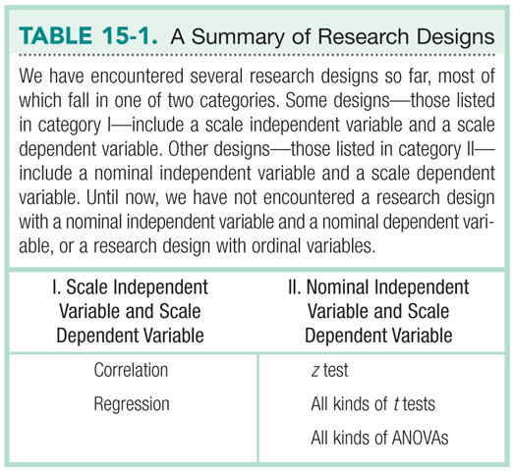
Parametric Tests

Slide 3
Nonparametric Tests
Used when assumptions for parametric tests are not met
Most commonly used when
  DV is nominal
  Either the IV or the DV is ordinal
  Sample size is small and we suspect underlying population is skewed

Slide 4
Limitations
Confidence intervals and effect size measures are not typically available
Less powerful than parametric tests
Increased risk of a Type II error
Nominal and ordinal scales provide less information about the variable of interest

Slide 5
Chi-Square
Chi-square test for goodness-of-fit
  Used with one nominal variable
  No IV or DV, just one categorical variable on which participants are sorted
Chi-square test for independence
  Used with two nominal variables
  Don’t ‘need’ to assign IV and DV, but researchers often do

Slide 6
Chi-Square Goodness-of-Fit
Measures how good the fit is between the observed data and the data we would expect according to H₀

Slide 7
Example
A researcher is investigating the physical characteristics that influence whether a person’s face is judged as beautiful.
The researcher selects a photograph of a woman and then creates two modifications of the photo
  Moves the eyes slightly farther apart
  Moves the eyes slightly closer together

Slide 8
Example
The three photos are shown to a sample of 150 college students who are asked to select the “most beautiful” of the three faces.
Original Photo | Eyes Moved Apart | Eyes Moved Together
51 | 72 | 27

Slide 9
Step 1: Identify
Population
  Population like the sample observed
  Population for which there is no difference preference among the categories
Comparison distribution
  Chi-square
Hypothesis test
  Goodness-of-fit
Assumptions
  Variable of interest is nominal
  Each observation is independent of all other observations
  Participants are randomly selected
  Minimum expected frequency in each cell >5

Slide 10
Step 2: H₀ & H₁
Null Hypothesis
  There is no preference among the different categories
Research Hypothesis
  The proportions differ from one category to another

Slide 11
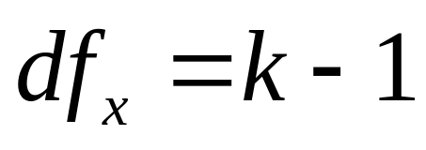
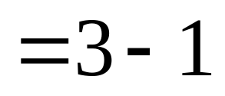
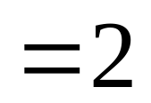
Step 3: Identify the Sampling Distribution
Calculate df
  based on the numbers of categories (cells) into which participants can be sorted
2

Slide 12
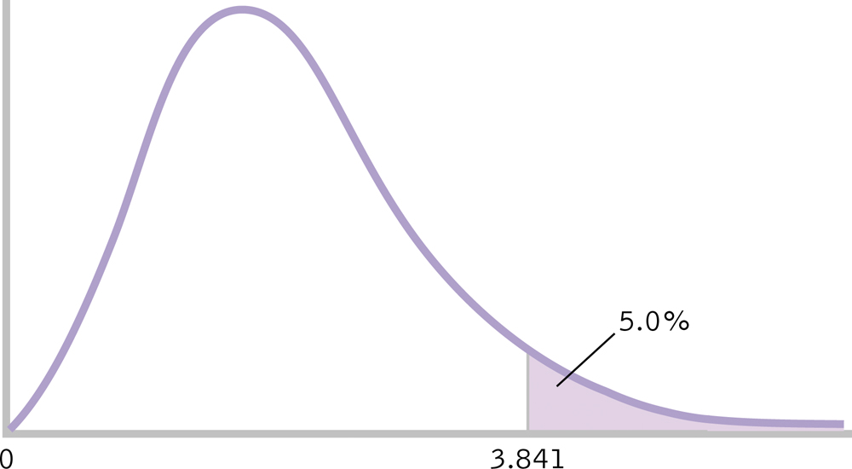
Step 4: Determine Critical Value
Critical X² = 5.992
5.992

Slide 13
Step 5: Calculate x²
Determine observed and expected frequencies
Category | Observed | Expected
Original Photo | 51 | 50
Eyes Moved Apart | 72 | 50
Eyes Moved Together | 27 | 50

Slide 14
Step 5: Calculate x²
Category | O | E | O-E | (O-E)² | (O-E)²/E
Original Photo | 51 | 50 | 1 | 1 | 0.02
Eyes Moved Apart | 72 | 50 | 22 | 484 | 9.68
Eyes Moved Together | 27 | 50 | -23 | 529 | 10.58

Slide 15
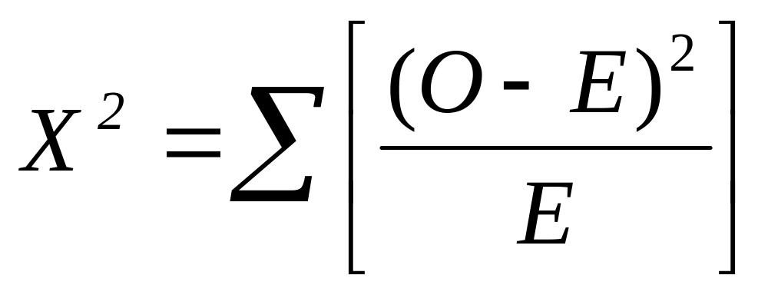
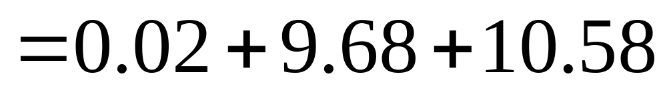
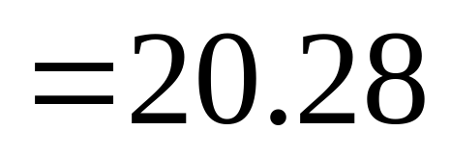
Step 5: Calculate x²

Slide 16
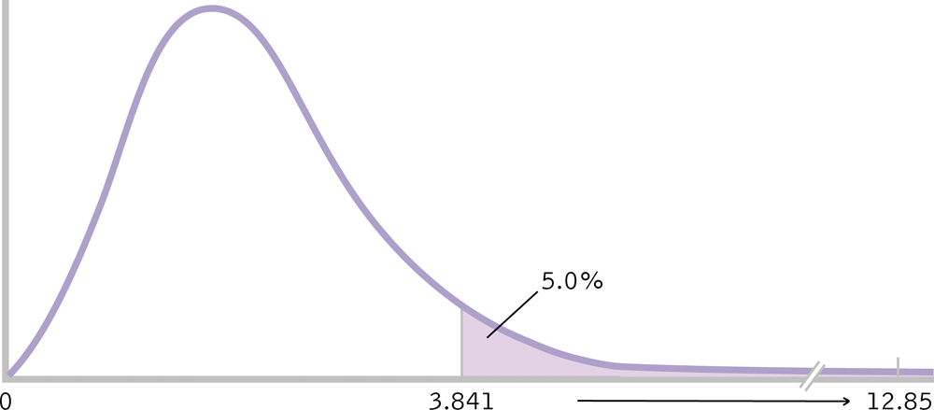
Step 6: Make a Decision
5.992
41.14
20.28

Slide 17
Step 6: Make a Decision
Reject H₀
The three photographs are not equally preferred. The photo with the eyes moved apart is selected more often and the photo with the eyes moved together is selected less often than expected, X²(2, N = 150) = 20.28, p < .05.

Slide 18
Your Turn
A psychologist examining art appreciation selected an abstract painting that had no obvious top or bottom. Hangers were placed on the painting so that it could be hung with any one of the four sides at the top. The painting was shown to a sample of N=50 participants, and each was asked to hang the painting in the orientation that looked correct.
Top up (correct) | Bottom up | L side up | R side up
18 | 17 | 7 | 8

